Slide 1
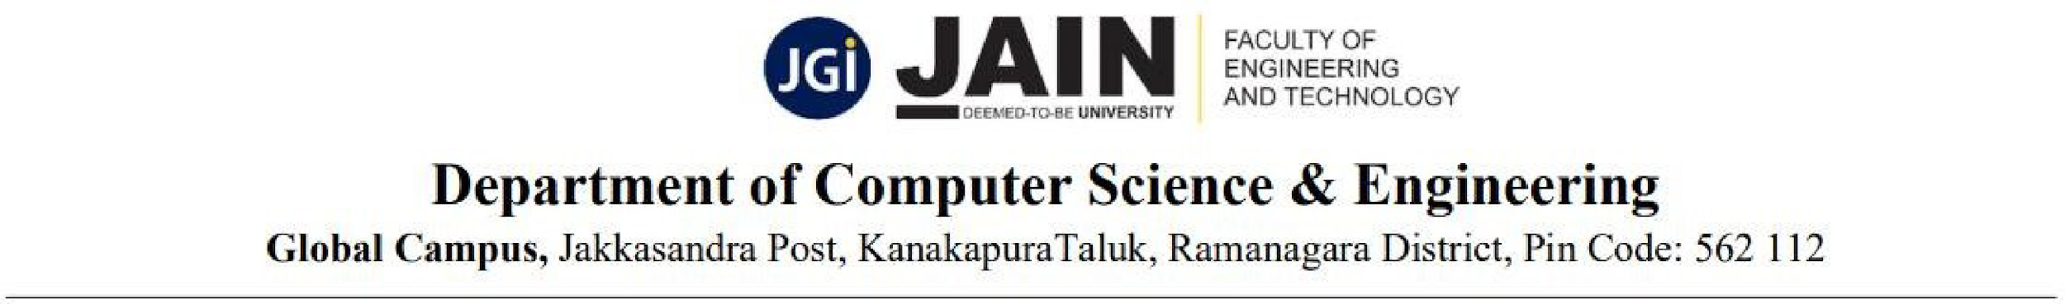
Team No. 21
PROSTATE CANCER PREDICTION USING DEEP LEARNING
TEAM MEMBERS:
P. DINISHITHA REDDY (23BTRCL065)
B. SUMITH REDDY (23BTRCL171)
D. MAHESH (23BTRCL177)
B. TEJESHWARA REDDY (23BTRCL253)
B.SADWIK(23BTRCL170)
Guided By,
Dr. S. Kanithan,
Assistant Professor / CSE(AIML)

Slide 2
CONTENTS
Abstract
Introduction
Literature Survey
Existing system
Proposed System
Block diagram
Conclusion
References

Slide 3
ABSTRACT
Prostate cancer is one of the most prevalent cancers among men, and early detection significantly improves treatment outcomes. This project proposes a deep learning-based approach using MRI images to classify whether a patient is affected by prostate cancer. The system leverages convolutional neural networks (CNN) for feature extraction and classification. Data preprocessing steps include resizing, normalization, and augmentation to enhance model robustness. The proposed framework demonstrates potential in achieving high accuracy, validated through ROC, AUC, accuracy, and confusion matrix evaluation. The model is deployed with a simple Flask-based backend and an interactive web interface for uploading MRI scans and viewing predictions.

Slide 4
INTRODUCTION
Prostate cancer accounts for a major portion of male cancer cases worldwide.
Traditional diagnosis methods such as biopsies and manual MRI examination are time-consuming and error-prone.
Deep learning techniques can automate detection by learning discriminative patterns from MRI scans.
This system integrates preprocessing, CNN-based classification, and web deployment for practical usability.

Slide 5
LITERATURE SURVEY
Litjens et al. (2017) - A survey on deep learning in medical image analysis"This work presents a comprehensive overview of deep learning applications in medical imaging. The authors emphasize the success of convolutional neural networks (CNNs) in tasks like lesion detection, segmentation, and classification. In the context of prostate cancer, CNNs have been applied to MRI and histopathology images, demonstrating improved accuracy and reduced need for manual annotation. This paper laid the groundwork for subsequent research by highlighting the potential of DL in cancer diagnosis.
Arif et al. (2020) - "Deep learning for classification of prostate cancer whole-slide histopathology images"Arif and colleagues developed a CNN-based model to classify prostate cancer grades from whole-slide histopathology images. They emphasized the importance of training on image patches to manage large image sizes. Their model achieved high classification accuracy and robustness, showcasing deep learning's ability to handle the complexity of histological data in prostate cancer diagnosis.

Slide 6
EXISTING SYSTEM
Manual diagnosis based on radiologists’ interpretation of MRI scans.
Higher chances of human error due to image complexity.
Traditional machine learning models require handcrafted features.
Lack of real-time user-friendly platforms for prediction.

Slide 7
PROPOSED SYSTEM
At this stage, the system leverages Transfer Learning to overcome the limitations of a basic CNN. Pre-trained models such as ResNet50, VGG16, or InceptionV3, trained on large-scale datasets like ImageNet, are repurposed for prostate MRI classification. This approach significantly improves accuracy, efficiency, and generalization.
Model: Instead of training from scratch, the framework employs a Transfer Learning backbone (ResNet50, VGG16, or InceptionV3). These architectures provide robust, pre-learned feature extractors capable of identifying complex spatial patterns in MRI scans.
Preprocessing: In addition to resizing and normalization, data augmentation techniques such as rotation, flipping, scaling, and contrast adjustment are applied. These steps increase dataset diversity, reduce overfitting, and enable the model to generalize better to unseen MRI scans.
Training: The lower layers of the pre-trained model are frozen, preserving generic visual features, while upper layers are fine-tuned with prostate-specific data. This balance allows the model to adapt to domain-specific features while maintaining efficiency. Gradient descent optimization and regularization are applied to ensure convergence.

Slide 8
PROPOSED SYSTEM
4. Evaluation: Model performance is evaluated using expanded metrics:
Accuracy: Overall correctness of predictions.
Precision: Reliability of positive cancer predictions.
Recall (Sensitivity): Ability to detect actual cancer cases.
F1-score: Balanced measure combining precision and recall. These metrics provide a more comprehensive view of model performance compared to the baseline CNN, which relied primarily on accuracy.
Limitation: While Transfer Learning delivers higher accuracy and robustness than the baseline model, the system still performs binary classification only. It does not provide tumor localization or severity analysis, which are critical for treatment planning

Slide 9
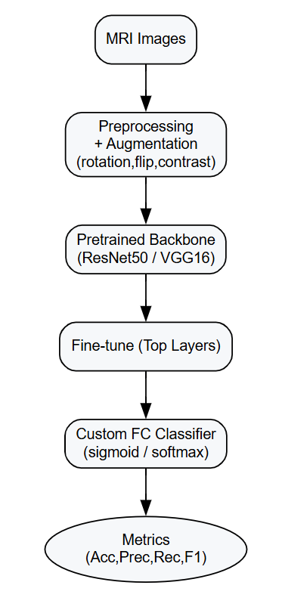
PROPOSED SYSTEM

Slide 10
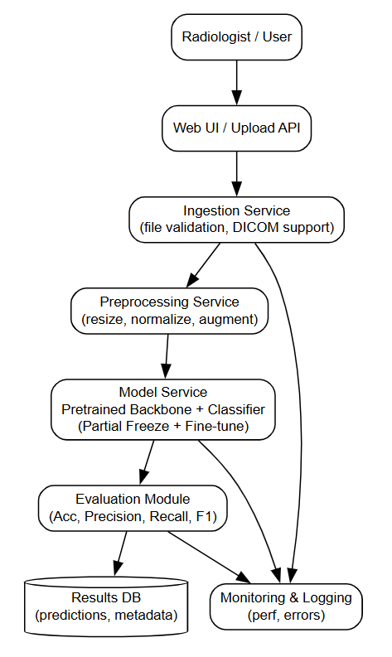
BLOCK DIAGRAM
The architecture begins with the Radiologist/User, who uploads prostate MRI scans via a Web UI or API. The Ingestion Service handles file validation and supports medical imaging formats such as DICOM. The data is then passed to a Preprocessing Service, where resizing, normalization, and augmentation are applied to enhance model generalization.
Next, the scans are analyzed by the Model Service, which integrates a pre-trained backbone (ResNet50, VGG16, or InceptionV3) with a custom classifier. Lower layers remain frozen, while upper layers are fine-tuned for prostate-specific feature learning.
Predictions are evaluated in the Evaluation Module, using accuracy, precision, recall, and F1-score to ensure robust assessment. Results are stored in the Database, while system activity and performance are tracked through the Monitoring and Logging module for transparency and reliability.
This architecture provides higher accuracy and stability than the baseline CNN, though it remains limited to binary cancer detection.

Slide 11
Conclusion
A CNN-based deep learning framework was developed for automated prostate cancer prediction.
Preprocessing and augmentation improved model generalization.
The system achieved reliable accuracy and interpretability through confusion matrix and ROC analysis
Deployment as a Flask web app makes it practical for real-time clinical support.
Future work: integrating explainable AI (e.g., Grad-CAM heatmaps) and expanding datasets for higher robustness

Slide 12
References
Esteban, L. M., Borque-Fernando, Á., Escorihuela, M. E., Esteban-Escaño, J., Abascal, J. M., Servian, P., & Morote, J. (2025). Integrating radiological and clinical data for clinically significant prostate cancer detection with machine learning techniques. Scientific reports, 15(1), 4261.
Alataş, E., Tanyıldızı Kökkülünk, H., Tanyıldızı, H., & Alcın, G. (2025). Treatment prediction with machine learning in prostate cancer patients. Computer Methods in Biomechanics and Biomedical Engineering, 28(4), 572-580.
Li, Y., Zhou, T., Liu, Z., Zhu, X., Wu, Q., Meng, C., & Deng, Q. (2025). Air pollution and prostate cancer: Unraveling the connection through network toxicology and machine learning. Ecotoxicology and Environmental Safety, 292, 117966.
Singh, S., Pathak, A. K., Kural, S., Kumar, L., Bhardwaj, M. G., Yadav, M., ... & Jain, G. (2025). Integrating miRNA profiling and machine learning for improved prostate cancer diagnosis. Scientific Reports, 15(1), 30477.
Yao, F., Lin, H., Xue, Y. N., Zhuang, Y. D., Bian, S. Y., Zhang, Y. Y., ... & Pan, K. H. (2025). Multimodal imaging deep learning model for predicting extraprostatic extension in prostate cancer using MpMRI and 18 F-PSMA-PET/CT. Cancer Imaging, 25(1), 103.

Slide 13
THANK YOU

